Slide 1

Indian Insititute of Information Technology, Allahabad
Decentralized Privacy Preserving Compliance Verification in Software Supply Chain
Name : Shalini T S
Enrollment No: MCL2024003
Supervisor: Dr. Soumyadev Maity

Slide 2
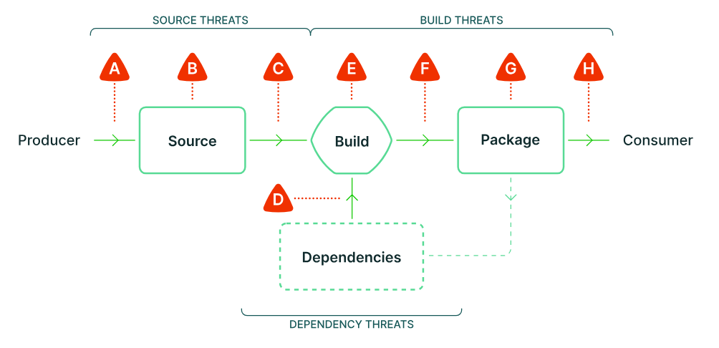
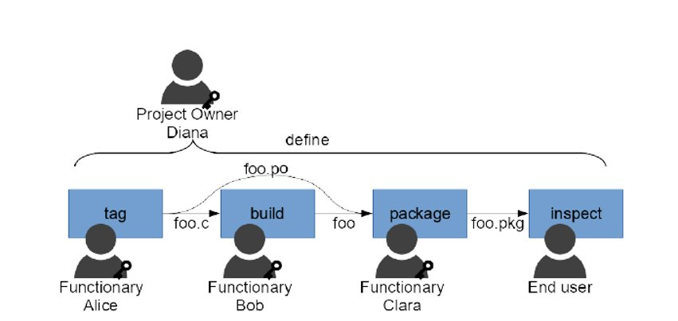
Software Supply Chain Management
Source: https://slsa.dev/spec/v1.0/threats-overview
Notes:
Verifies the integrity of code, dependencies, and cryptographic signatures; detailed inventory of software components for traceability. An attacker that is able to compromise any single step in the process can maliciously modify the software and harm any of the software’s users.

Slide 3
Need for Privacy and Decentralization in Software Supply Chain
Issue | Risks | Challenges
Artifact Integrity | Artifact tampering during build/deployment. | Proving correctness without revealing internal data.
Provenance Tracking | Unverifiable records in CI/CD pipelines. | Tracking steps without exposing sensitive data.
Dependency Management | Malicious dependencies in trusted packages. | Verifying dependency integrity without revealing full trees.
Audit and Compliance | Limited visibility into security policy adherence. | Proving policy adherence without exposing configurations.

Slide 4
Decentralized Privacy Preserving Software Compliance Verification In Software Supply Chain Management
Problem Statement
Enhanced Security
Data Integrity with Privacy
Confidentiality in Supply Chain
Trustless Verification
Auditable Provenance
Efficient Proof Mechanisms

Slide 5
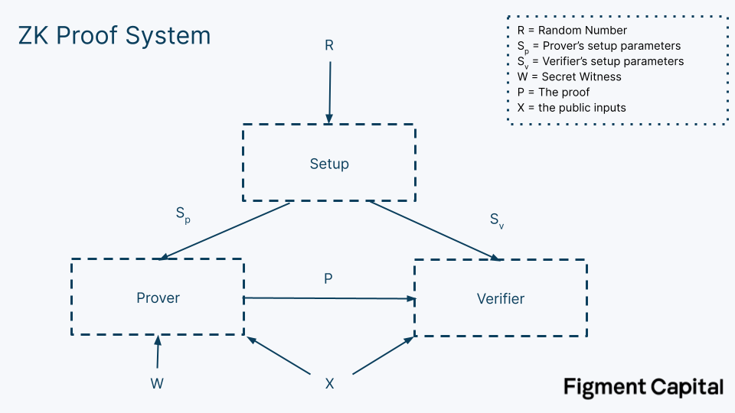
Zero Knowledge Proof
Prover convinces a verifier of a statement's validity without disclosing any additional information.
Types
Interactive ZKP
Non-Interactive ZKP
Privacy Preserving Verifiability
Source: https://figmentcapital.medium.com/accelerating-zero-knowledge-proofs-cfc806de611b
Notes:
I-Involves multiple rounds of communication; NI-single exchange using a common reference string

Slide 6
How SSC Security is Achieved by in-Toto?
Layout - signed by P.M
Metadata - signed by Functionaries
Link Metadata
Predicate Metadata
Notes:
Verifies the integrity of code, dependencies, and cryptographic signatures; detailed inventory of software components for traceability. An attacker that is able to compromise any single step in the process can maliciously modify the software and harm any of the software’s users.

Slide 7
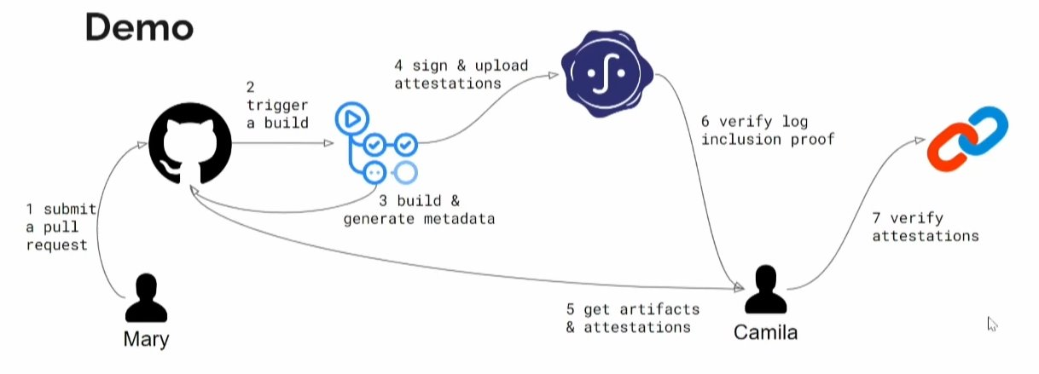
In-toto Workflow Demo
Source : https://in-toto.io/docs/

Slide 8
Layout
Signature of project manager/owner
Steps of the Software supply chain
List of public keys of authorized functionaries for each step
Threshold of signatures for each step
Expected Materials & Products
Expected Predicates
Byproducts & Commands
Inspections

Slide 9
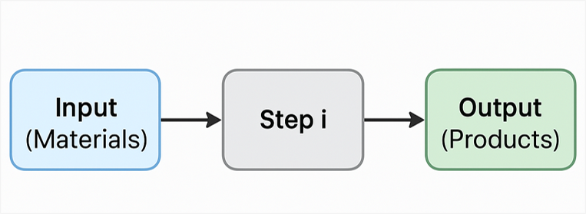
Link-Metadata
Corresponds to a step in the Supply chain
Generated by any authorized functionary
Signed by the functionary
Contains
Materials
Products
ByProducts
Commands
Signature of functionary

Slide 10
Predicates
Subject info
Subject Name
Subject Hash
Predicate type
Link
Test-result
SLSA etc,.
Predicate-Specific metadata related to Subject
Signature of the Functionary

Slide 11
In-Toto Verification
Public key of project manager
layout
verify
Valid / Invalid
Link-metadata-1
Link-metadata-2
…
Link-metadata-n
Notes:
Verifies the integrity of code, dependencies, and cryptographic signatures; detailed inventory of software components for traceability. An attacker that is able to compromise any single step in the process can maliciously modify the software and harm any of the software’s users.

Slide 12
in-Toto Verification Algorithm
Verify Digital Signature of the layout
Check Expiration Date of the layout
for each Claim in Claim-Set
Check if the claim has been generated by authorized functionary
Verify digital signature of the claim using the functionary’s public key
Verify “material rule” using the “Link-Predicate”
Verify “product rule” using the “Link-Predicate”
Verify each “predicate rule” using the corresponding Predicate-Claim
NOTE: “material rule” + “product rule” = “artifact rule”

Slide 13
Artifact Rules
CREATE <pattern>
DELETE <pattern>
MODIFY <pattern>
ALLOW <pattern>
DISALLOW <pattern>
REQUIRE <file>
MATCH <pattern> [IN <source-path-prefix>] WITH (MATERIALS|PRODUCTS) [IN <destination-path-prefix>] FROM <step>
NOTE: “material rule” + “product rule” = “artifact rule”

Slide 14
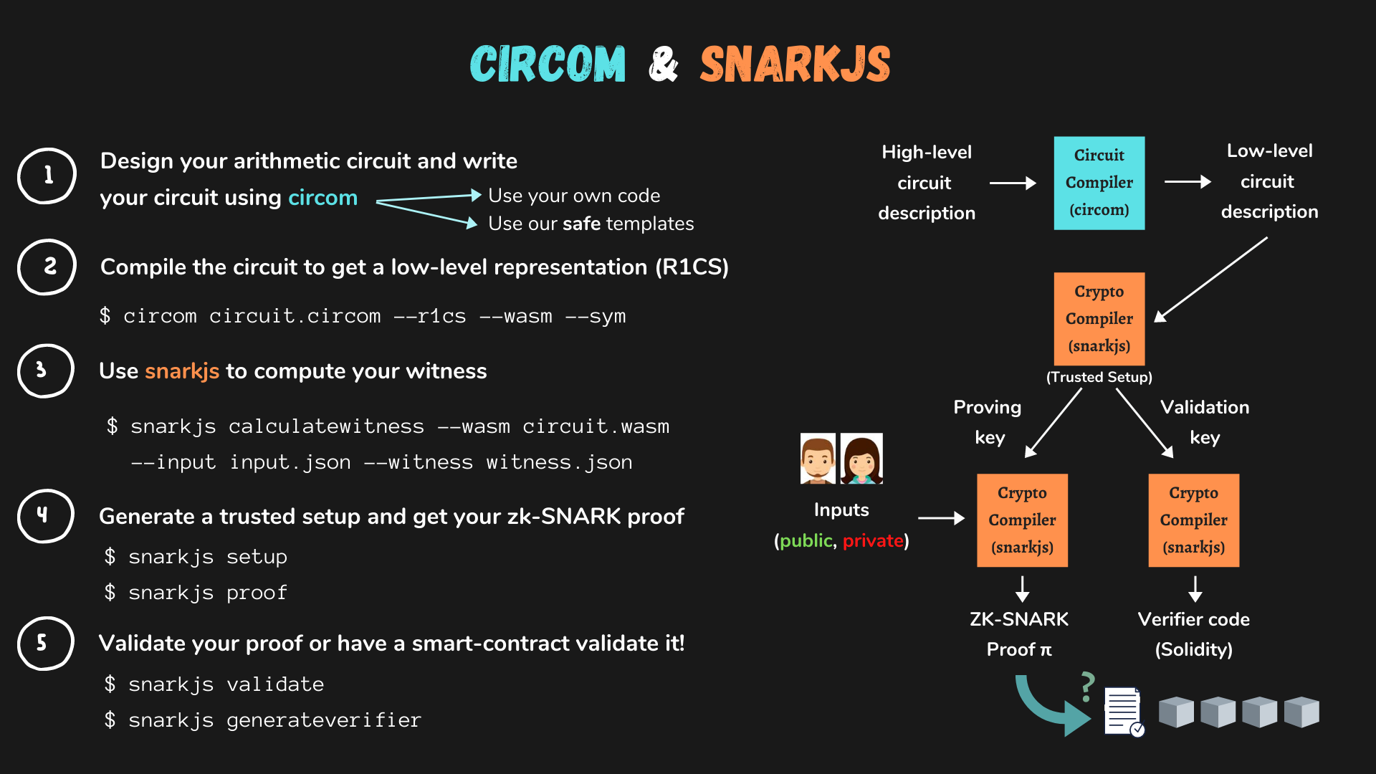
Tools to Implement ZKP
Source: https://docs.circom.io/

Slide 15
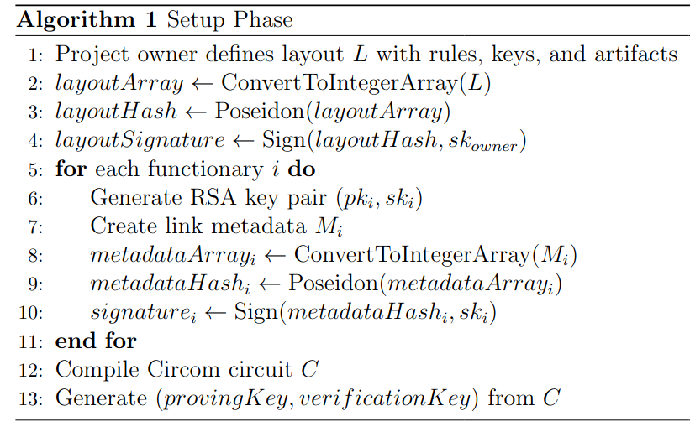
Setup phase
Proposed Design
Notes:
Verifies the integrity of code, dependencies, and cryptographic signatures; detailed inventory of software components for traceability. An attacker that is able to compromise any single step in the process can maliciously modify the software and harm any of the software’s users.

Slide 16
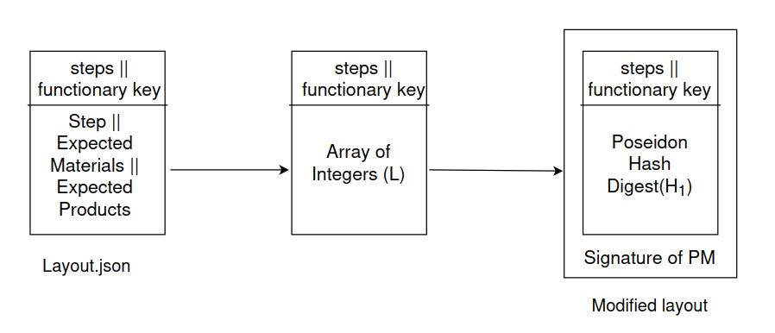
Data Preparation for Circom
Proposed Design
Notes:
Verifies the integrity of code, dependencies, and cryptographic signatures; detailed inventory of software components for traceability. An attacker that is able to compromise any single step in the process can maliciously modify the software and harm any of the software’s users.

Slide 17
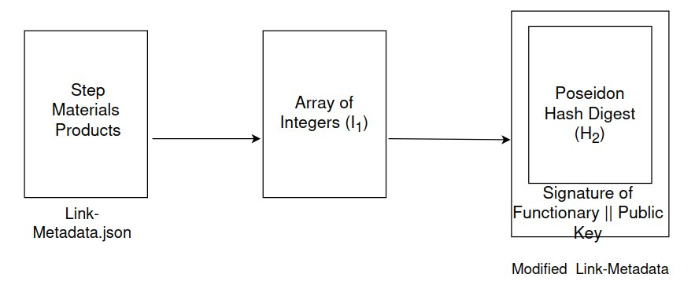
Data Preparation for Circom
Proposed Design
Notes:
Verifies the integrity of code, dependencies, and cryptographic signatures; detailed inventory of software components for traceability. An attacker that is able to compromise any single step in the process can maliciously modify the software and harm any of the software’s users.

Slide 18
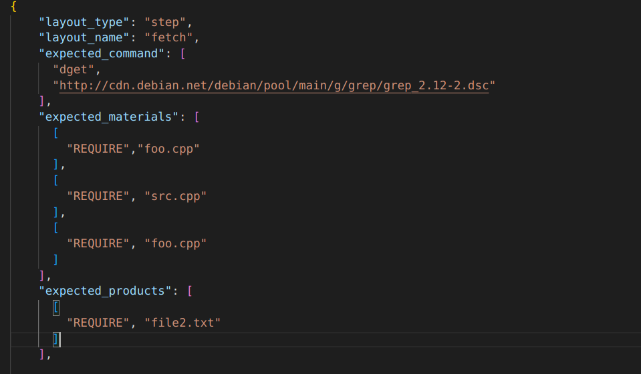
Data Preparation Layout for Circom
Proposed Design
Notes:
Verifies the integrity of code, dependencies, and cryptographic signatures; detailed inventory of software components for traceability. An attacker that is able to compromise any single step in the process can maliciously modify the software and harm any of the software’s users.

Slide 19
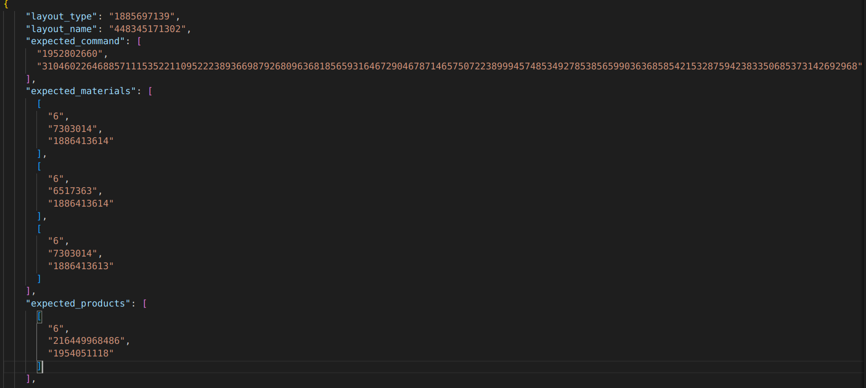
Data Preparation of Layout for Circom
Proposed Design
Notes:
Verifies the integrity of code, dependencies, and cryptographic signatures; detailed inventory of software components for traceability. An attacker that is able to compromise any single step in the process can maliciously modify the software and harm any of the software’s users.

Slide 20
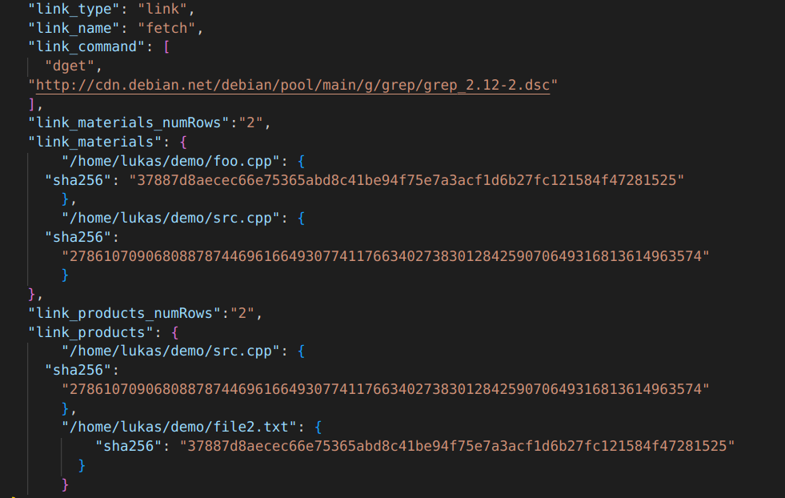
Data Preparation of Link-Metadata for Circom
Proposed Design
Notes:
Verifies the integrity of code, dependencies, and cryptographic signatures; detailed inventory of software components for traceability. An attacker that is able to compromise any single step in the process can maliciously modify the software and harm any of the software’s users.

Slide 21
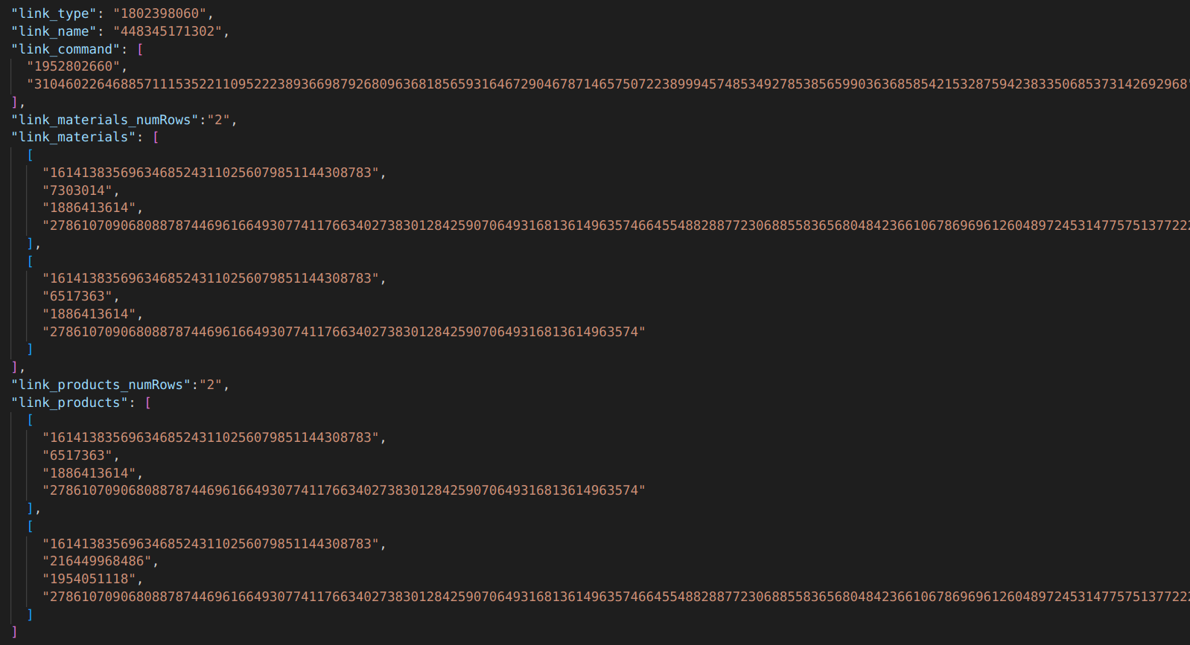
Data Preparation of Link – Metadata for Circom
Proposed Design
Notes:
Verifies the integrity of code, dependencies, and cryptographic signatures; detailed inventory of software components for traceability. An attacker that is able to compromise any single step in the process can maliciously modify the software and harm any of the software’s users.

Slide 22
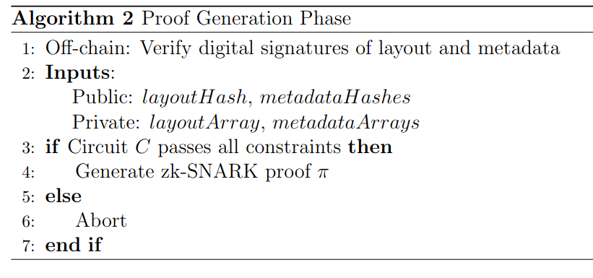
Proof Generation phase
Proposed Design
Notes:
Verifies the integrity of code, dependencies, and cryptographic signatures; detailed inventory of software components for traceability. An attacker that is able to compromise any single step in the process can maliciously modify the software and harm any of the software’s users.

Slide 23
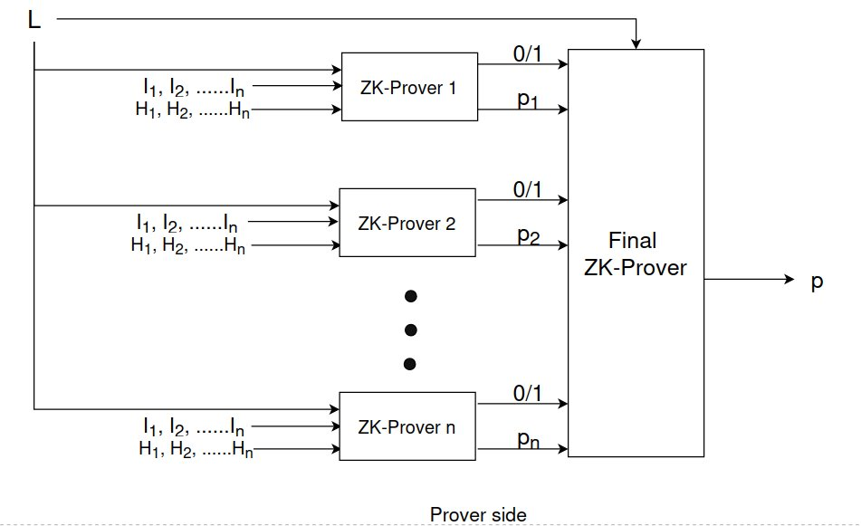
Prototype Design of Recursive ZK-SNARK
Proposed Design
Notes:
Verifies the integrity of code, dependencies, and cryptographic signatures; detailed inventory of software components for traceability. An attacker that is able to compromise any single step in the process can maliciously modify the software and harm any of the software’s users.

Slide 24
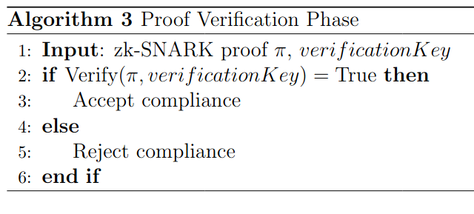
Proof Verification phase
Proposed Design
Notes:
Verifies the integrity of code, dependencies, and cryptographic signatures; detailed inventory of software components for traceability. An attacker that is able to compromise any single step in the process can maliciously modify the software and harm any of the software’s users.

Slide 25
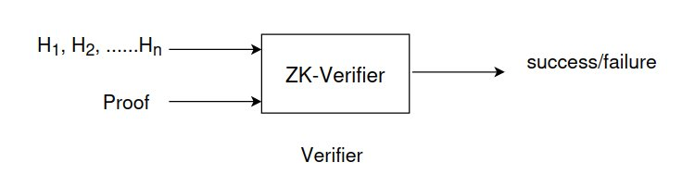
Proposed Prototype Design of ZK-SNARK
Proposed Design
Zk-Verifier is a solidity program, which will deployed on blockchain.
Notes:
Verifies the integrity of code, dependencies, and cryptographic signatures; detailed inventory of software components for traceability. An attacker that is able to compromise any single step in the process can maliciously modify the software and harm any of the software’s users.

Slide 26
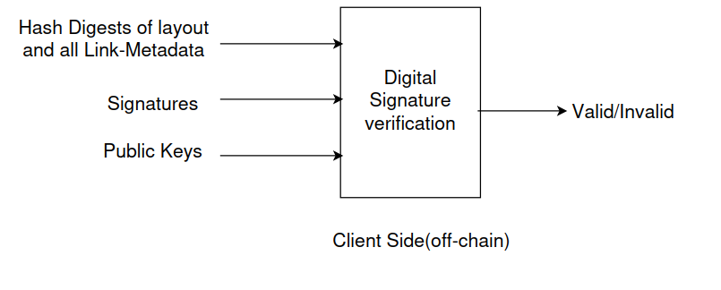
Prototype Design off-chain Digital Sign Verification
Proposed Design
Notes:
Verifies the integrity of code, dependencies, and cryptographic signatures; detailed inventory of software components for traceability. An attacker that is able to compromise any single step in the process can maliciously modify the software and harm any of the software’s users.

Slide 27
Security Benefits
Supply Chain Layout Integrity
Artifact Flow Integrity
Rule based Verification
Privacy Preservation
Compliance Assurance
Decentralization
End to end security and trust

Slide 28
What ZKP adds to in-toto?
Integration in to existing SSC without much change
Client only needs to perform 1 step verification
Embed proof on blockchain, making supply chain audit verifiable by smart contracts
Avoid trusting centralized verifiers; proofs can be verified independently
Prove compliance without revealing actual source, artifacts, or keys
Prove that internal policies were followed, without exposing internal pipelines

Slide 29
Future Timeline
Semester 3 – Project Implementation & Testing
Semester 4 - Experimentation & Report Writing

Slide 30
References
C. Okafor, T. R. Schorlemmer, S. Torres-Arias, and J. C. Davis, "SoK: Analysis of Software Supply Chain Security by Establishing Secure Design Properties," in Proceedings of the 2022 ACM Workshop on Software Supply Chain Offensive Research and Ecosystem Defenses (SCORED ’22), Los Angeles, CA, USA, Nov. 2022, pp. 1-10. doi: 10.1145/3560835.3564556.
S. Torres-Arias, H. Afzali, T. K. Kuppusamy, R. Curtmola, and J. Cappos, "in-toto: Providing farm-to-table guarantees for bits and bytes," in Proceedings of the 28th USENIX Security Symposium, 2019, pp. 1393-1410. [Online]. Available: https://www.usenix.org/conference/usenixsecurity19/presentation/torres-arias
M. Chase, C. Ganesh, and P. Mohassel, "Efficient Zero-Knowledge Proof of Algebraic and Non-Algebraic Statements with Applications to Privacy Preserving Credentials," in Proceedings of CRYPTO 2016, Part III, vol. 9816, pp. 499–530, Springer, Heidelberg, 2016. DOI: 10.1007/978-3-662-53015-3_18.
https://docs.circom.io/
https://slsa.dev/
https://github.com/in-toto
https://in-toto.io/docs/

